Slide 1


Slide 2
Problem
Information dissemination and gathering after a disaster is an important concern
Lack of personnel and volunteers for ground searching
Manual Methods are used

Slide 3
Solution
A non-internet dependent web platform on an autonomous rover where the victims are
INFORMED
On the different known facts about disasters
ADVISED
On what they must do
SHARE INFORMATION
On what happened on their premises

Slide 4
Market Validation
3,015,000
people homeless after the big one [MMEIRS] possible users of the web platform
21
Barangays affected by West Valley fault
Possible freemium users
Notes:
http://www.smh.com.au/comment/nepal-earthquake-rescue-teams-arrive-too-late-to-save-lives-its-time-to-rethink-how-we-respond-to-disasters-20150427-1muqn6.html

Slide 5
Market Size
P 38.9 Billion
P 5.364 Trillion
BUDGET
Philippine National Disaster
Risk Reduction Fund 2016
Disaster Response and Recovery
as a Market worth in 2020

Slide 6
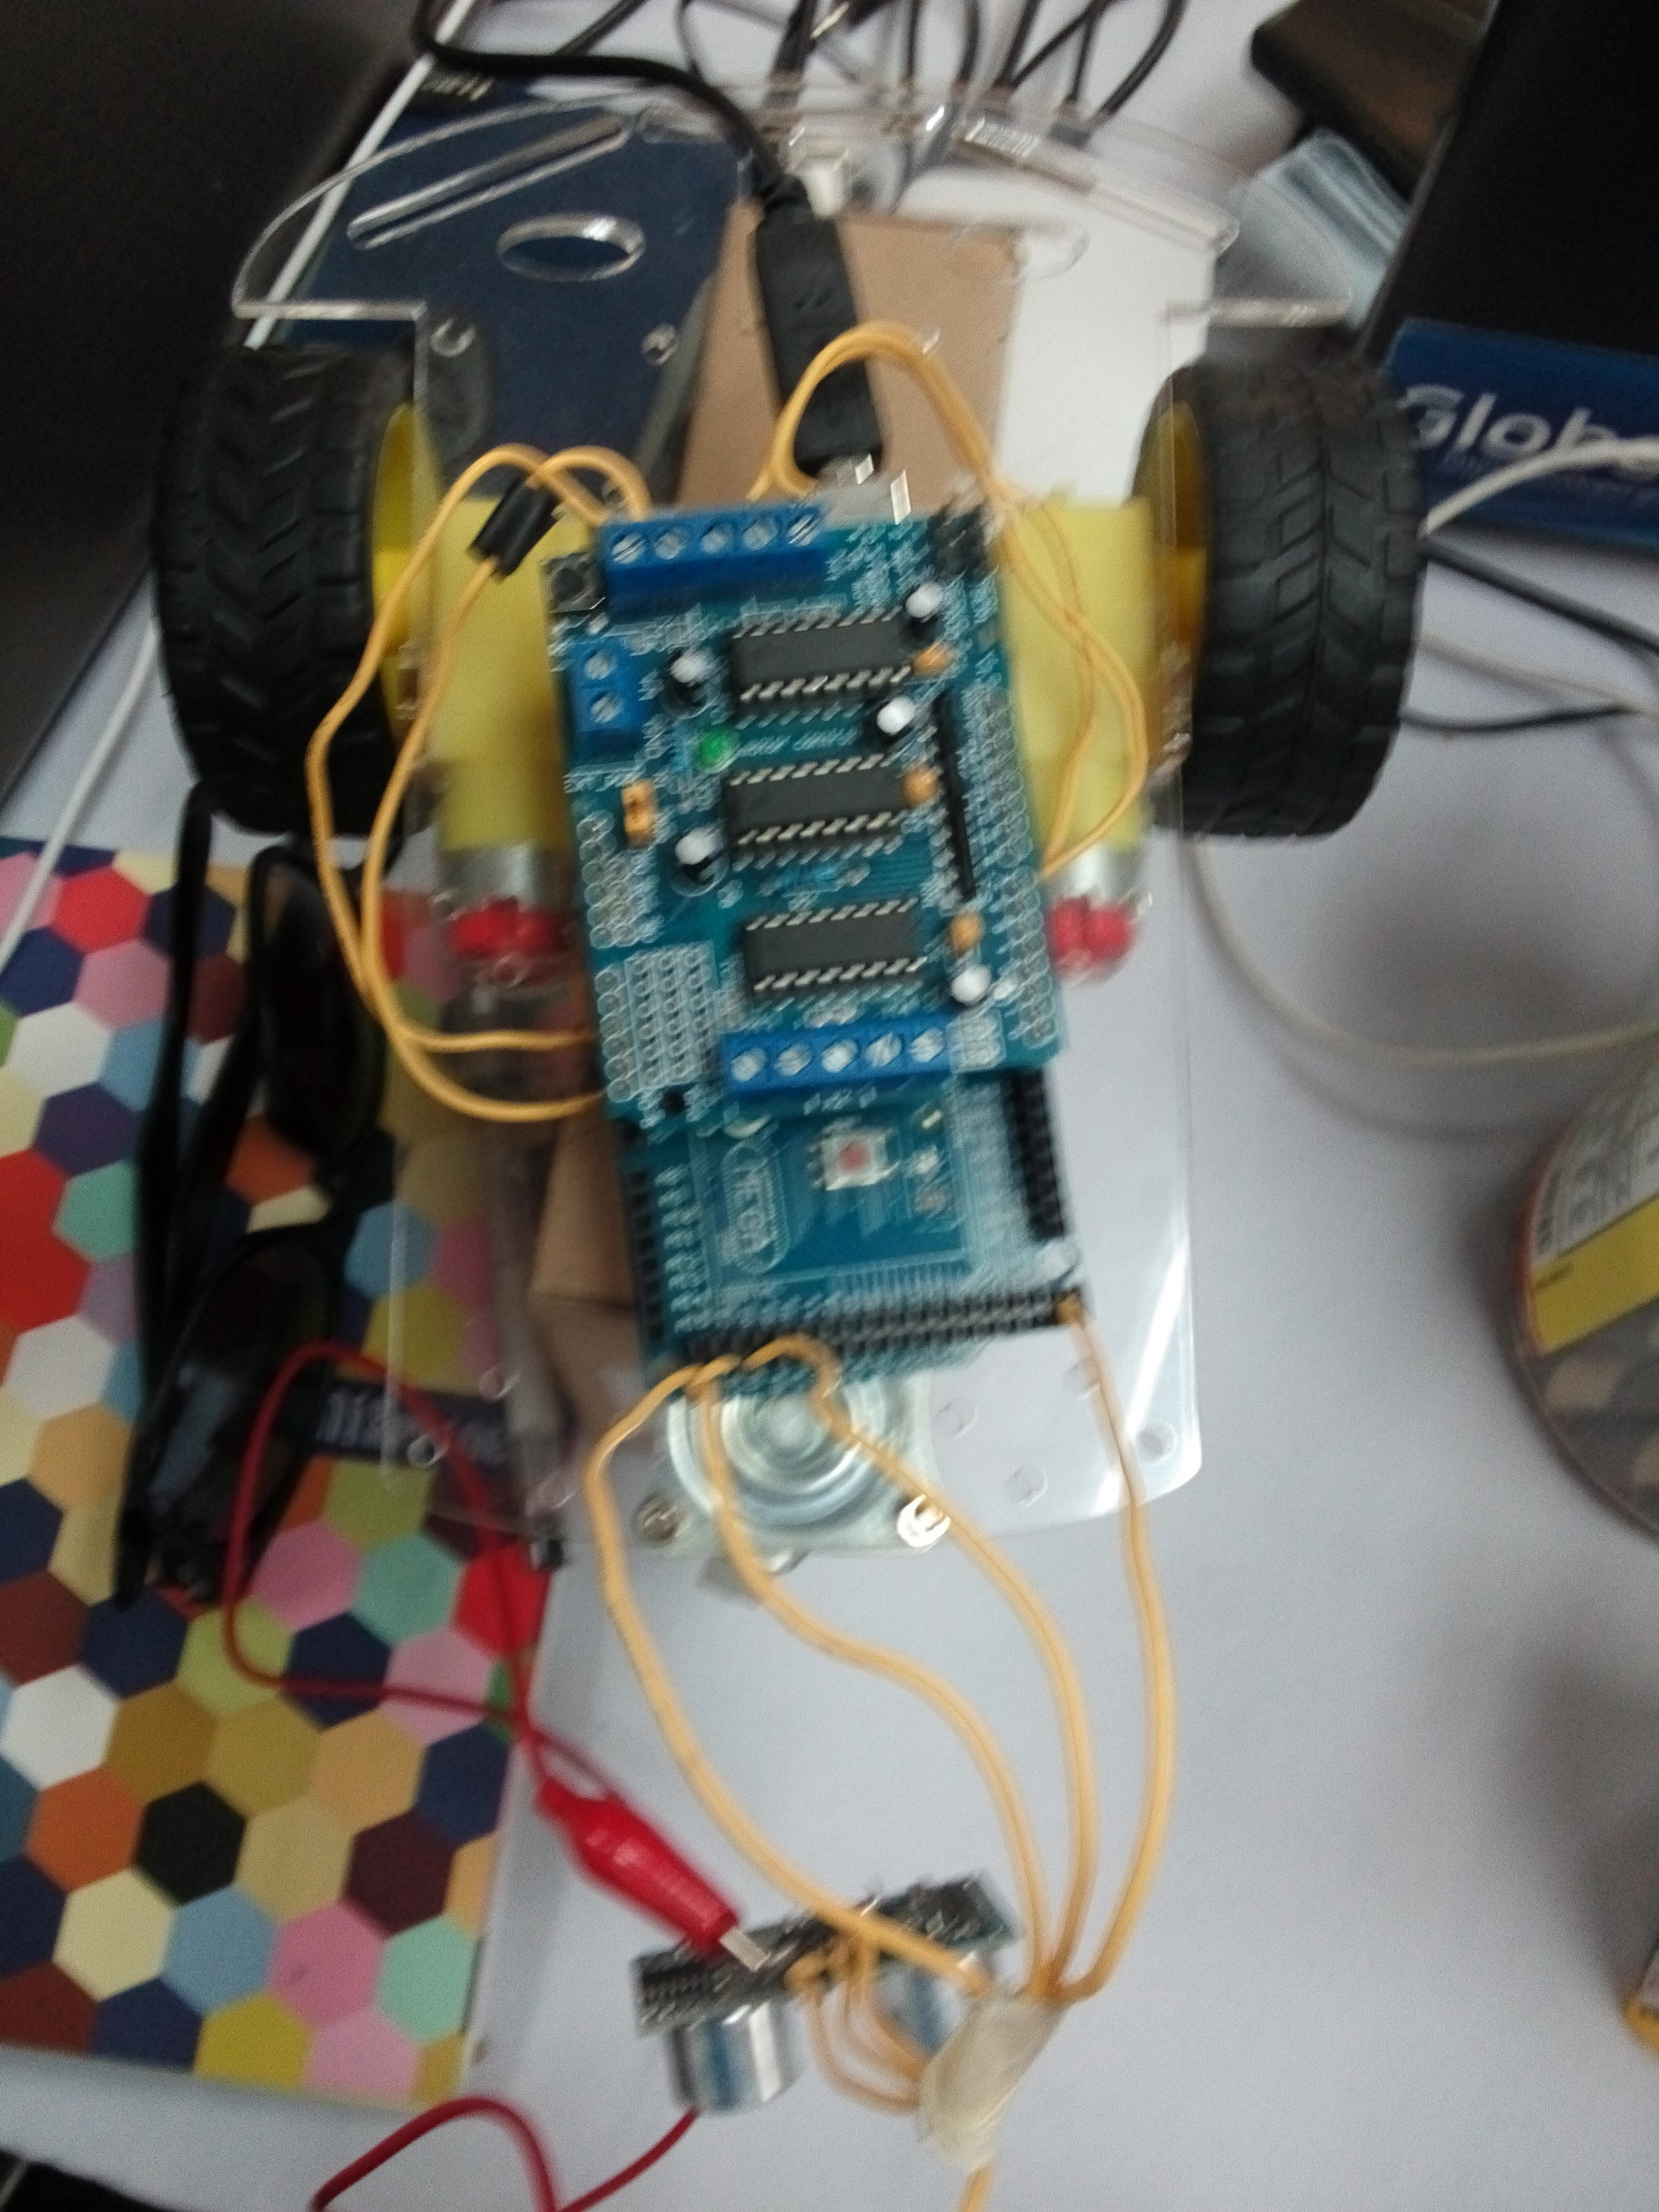
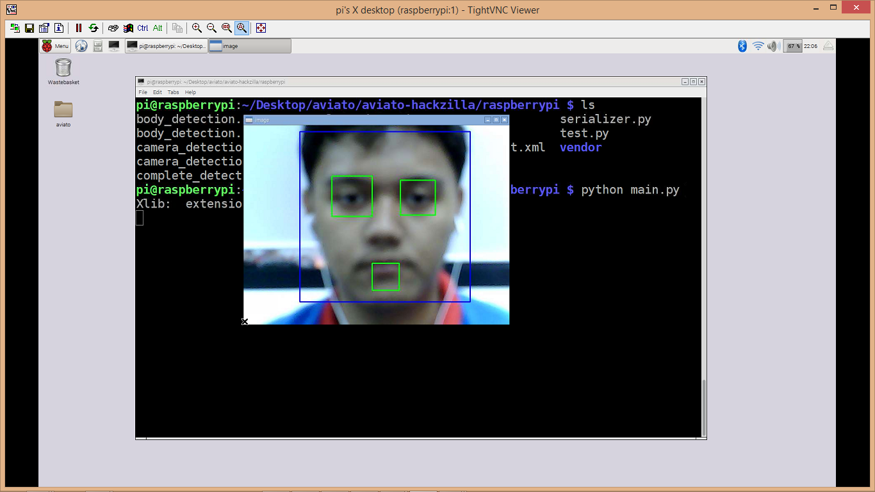
Product

Slide 7
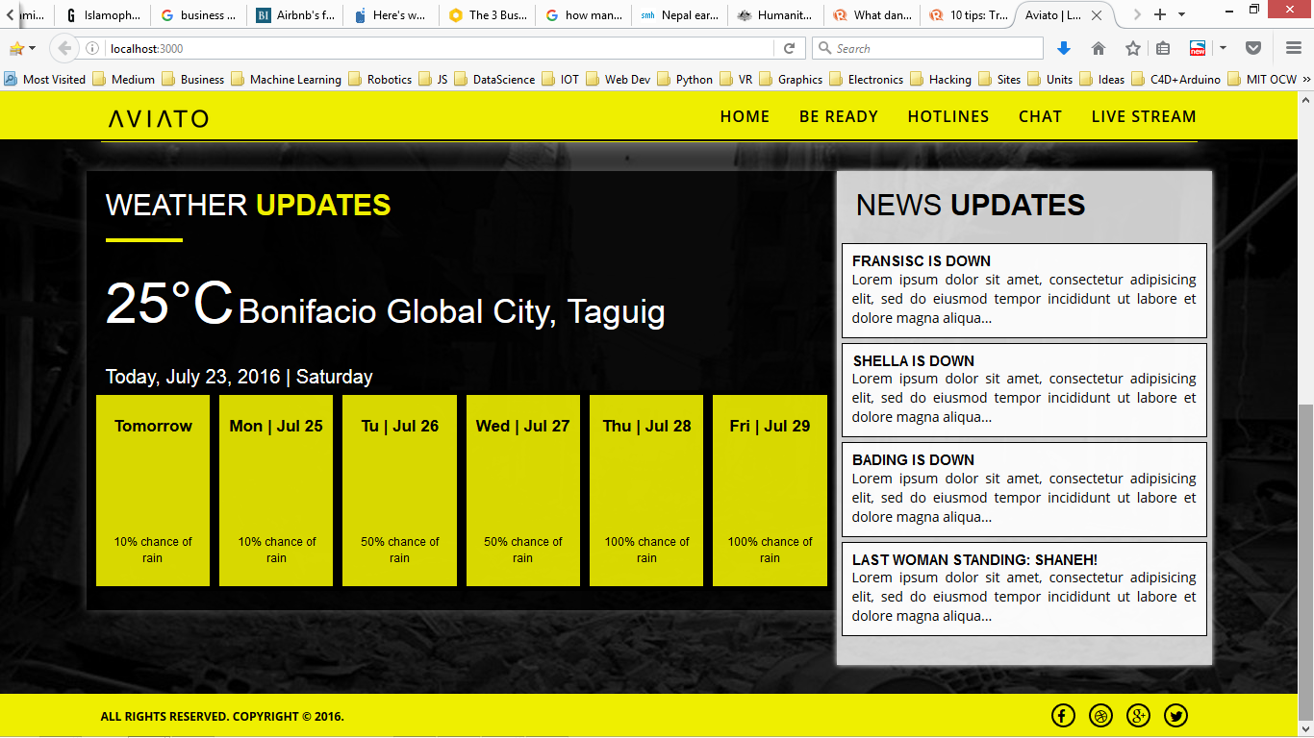
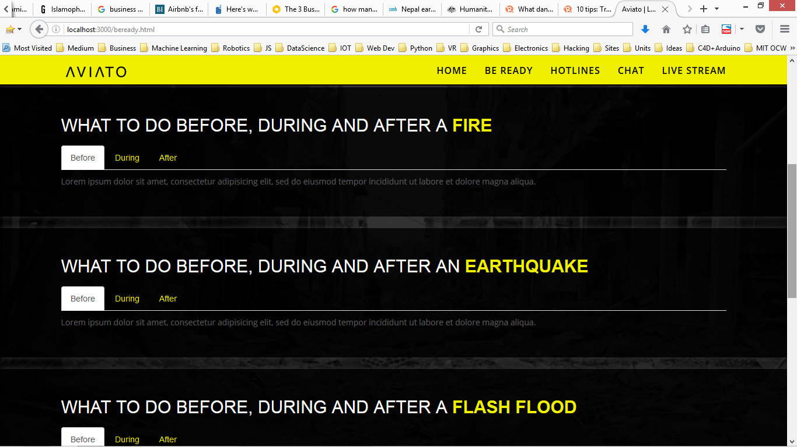
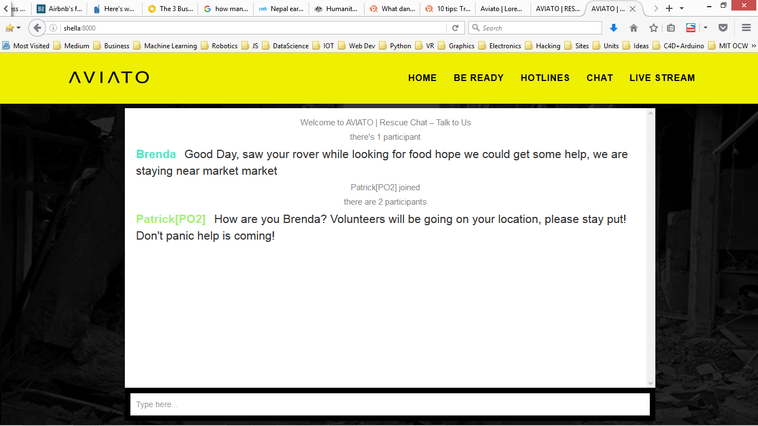
Product

Slide 8
Business Model [Hardware Enabled–Services]
Freemium – with a range of service plans to record, wider range, face-recognition database, captured images that will cost within the range of 15,000 – 30,000 php per month

Slide 9
Market Adoption
EVENTS
PARTNERSHIP
Launch of the MICIC Initiative Guidelines (Philippines)
Intensive Summer Course: Advancing Disaster Risk Reduction to Enhance Sustainable Development in a Changing World (Germany)
ASEM Manila Conference on Disaster Risk Reduction and Management (DRRM)
UNISDR
NDRRMC
ASEM
Notes:
https://www.unisdr.org/we/inform/events

Slide 10
Competition
Manual Method
Semi-Manual with current set of Technology

Slide 11
Competitive Advantages
1st to Market
Profiles
Design and Brand

